Slide 1
Idea/Approach details
Organization name : AICTE, MIC-Student Innovation
Problem Statement : SM951
Team Name : MIRACLE WORKERS
Team Leader Name : Saranya P

Slide 2
Idea
This task is created to facilitate crafted by understudies. The task includes a card which contains a standardized identification (barcode scanner, finger print sensor or face recognition) which is only an interesting card that is doled out to the understudy. This card can be topped off as and when expected by the understudy with the assistance of administrator. This card is helpful for the understudy in places like library, container and fixed shops. At the point when the card is embedded the remarkable id put away is examined and in like manner cash is deducted from the understudy's record. This card can be utilized to submit significant archives that will be required by the understudy for any of its work. This is finished by checking the extraordinary id put away in the card which is the shipped off the server where the understudy's archive is put away and is straightforwardly sent from the server any place required. Consequently the client doesn't need to convey its records generally. The understudy can involve this card in library to pay fine and how much fine will be determined relying upon the data put away which is recovered with the assistance of an ID put away in the card. Same way in the event of fixed shop where the money sum is deducted from the understudy's record and same way if there should arise an occurrence of container. In this way the understudy simply needs to convey the convenient card. Along these lines this card is extremely useful for an understudy and makes a significant number of its work simple.

Slide 3
Technology stack
• Artificial Intelligence
• Machine Learning
• Software requirements : map user requirements to software requirements
• Architectural design : Design the architecture of the solution
• Emulation : Use emulators to test the code on virtual card

Slide 4
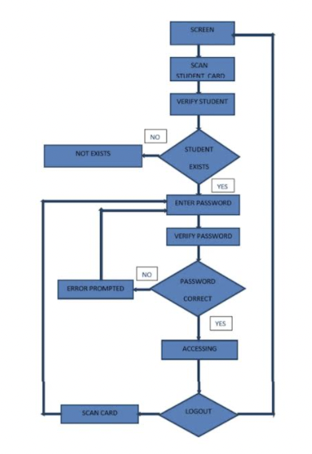
User Case

